Slide 1
Spontaneous Order and the Market Process
Steven Horwitz
IHS: Morality, Capitalism & Freedom
Summer 2010

Slide 2
Overview
Not all order is the product of design
A. Smith & the Scottish Enlightenment
Carl Menger and institutional evolution
F. A. Hayek and the role of knowledge
The market as a spontaneous order
Where does design begin and end?
Conflicting spontaneous orders

Slide 3
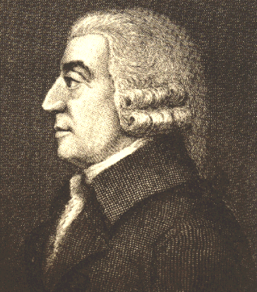
The products of human action but not human design
The “invisible hand”
Scots – Smith, Hume, Ferguson
Beneficial unintended consequences
Cooperation in anonymity
This is the beginning of social science

Slide 4
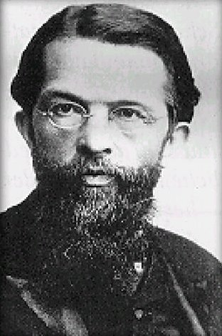
Carl Menger and the evolution of institutions
Subjectivism, marginalism, and methodological individualism
The “Mengerian question”
Organic vs. pragmatic
Compositive method
The evolution of money
From the division of labor to the division of knowledge

Slide 5
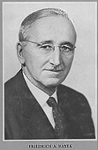
Knowledge and spontaneous order
Spontaneous orders as epistemological ecologies
“Made” vs. “Spontaneous”
Economy vs. catallaxy
Unified vs. diverse purposes
Command vs. abstract rules
Self-interest and altruism

Slide 6
Order in the market
The unplanned outcome of planned behavior
Prices as the central coordinator
Prices as knowledge surrogates
tacit vs. articulate knowledge
Spontaneous order, knowledge, complexity
why socialism fails
Competition as a discovery procedure

Slide 7
Some critical issues
The line between designed and unplanned
Firms
Government
What happens when spontaneous orders with different values conflict?
Ecological systems, democracy, and science

